Slide 1

A Business Data Management Study of Customer Demand and Operational Challenges at Metro Hotel and Restaurant, Singur
BDM Capstone Project
Name: SAMPRIKTA MALIK
Roll number: 21F3002038
Email: 21f3002038@ds.study.iitm.ac.in
Indian Institute of Technology Madras
Chennai,600036

Slide 2
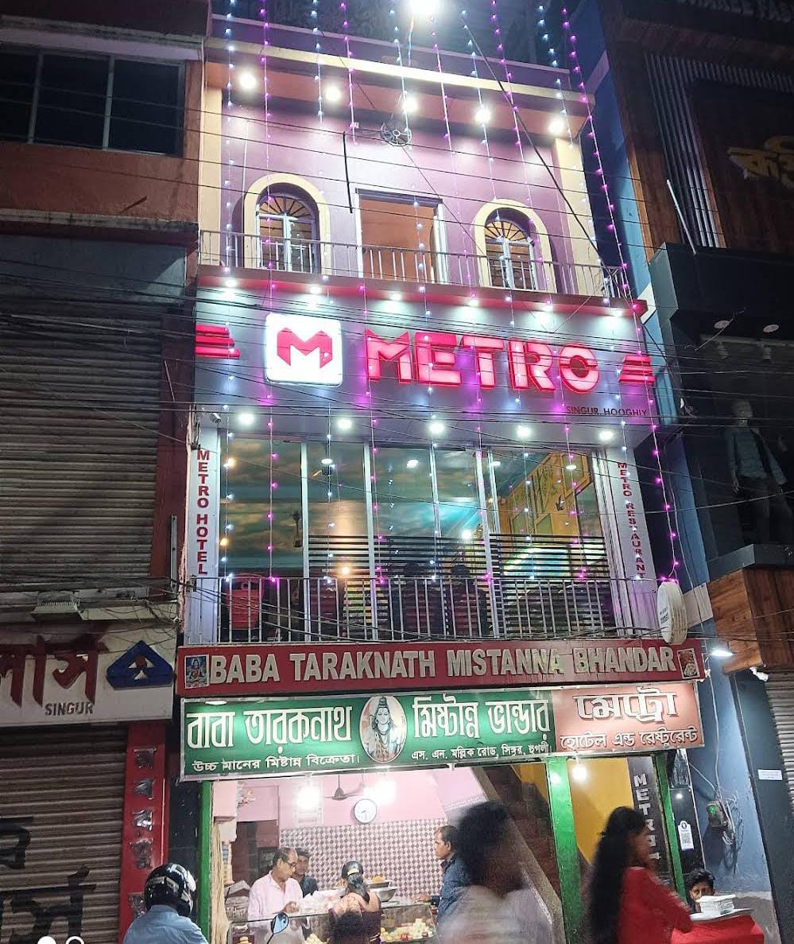
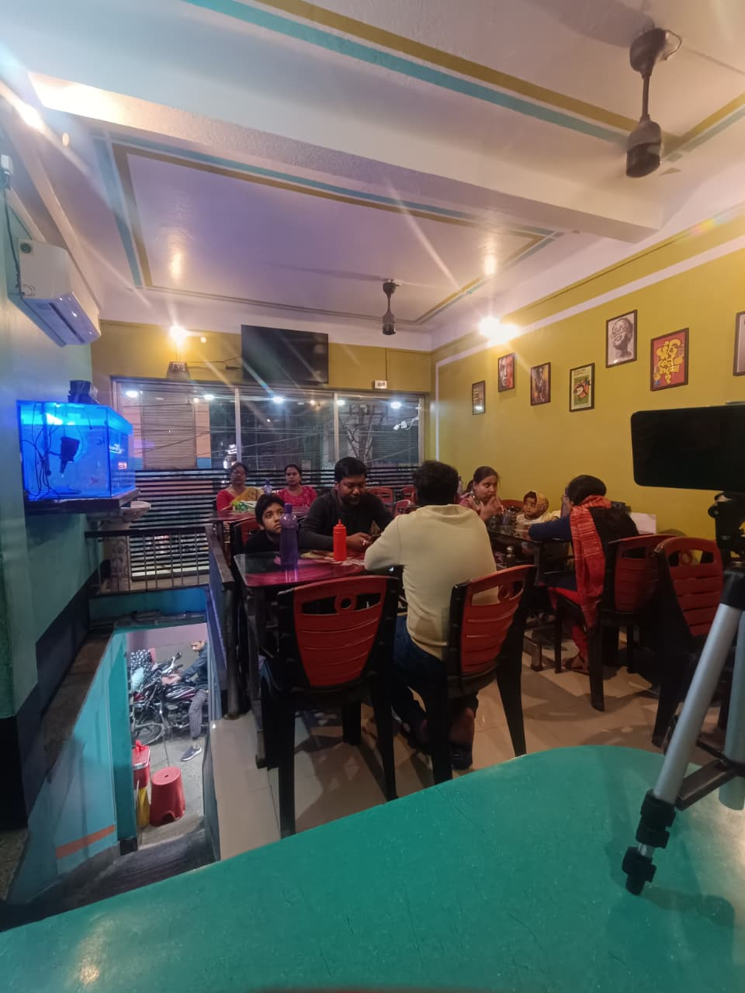
Overview
Organization Background
Metro Hotel & Restaurant, Singur
Family-run restaurant in Singur, Hooghly, West Bengal
Established in 1997
Operates in B2C (Business-to-Consumer) model
Offers dine-in and takeaway services
Serves affordable food (rice dishes, biriyani, etc.)
Operates with 6–8 staff managing daily activities
Business Problem
Difficulty in identifying high-revenue items
Unclear peak sales days
Uneven contribution across categories
Limited understanding of customer demand
Need for better revenue-focused decisions

Slide 3
Objectives, Data & Methodology
Objectives
Identify high-revenue items and categories
Analyze sales trends & peak demand days
Support data-driven business decisions
Data Used
Primary sales data
Period: Dec 2025 – Feb 2026 (3 months)
Item-level & daily sales data
Tool: Microsoft Excel
Methodology
• Cleaned missing and inconsistent data
• Standardized item names and categories
• Used pivot tables for day-wise and category analysis
• Ranked items based on total revenue
• Applied Pareto analysis

Slide 4
Monthly Sales Trend
Insights:
The total revenue is approximately ₹13.53 lakh.
December: ₹4,58,105
January: ₹4,84,520 (Highest)
February: ₹4,10,390
Sales peak in Dec–Jan (festive impact)
February shows post-festive stability
Figure 1: Monthly Revenue Comparison (December–February)

Slide 5
Day-wise Sales Analysis
Insights:
Wednesday contributes ~
20% of total revenue
Wednesday records highest revenue
Mid-week demand stronger than weekends
Figure 2: Day-wise Revenue Distribution (3 Months Combined)

Slide 6
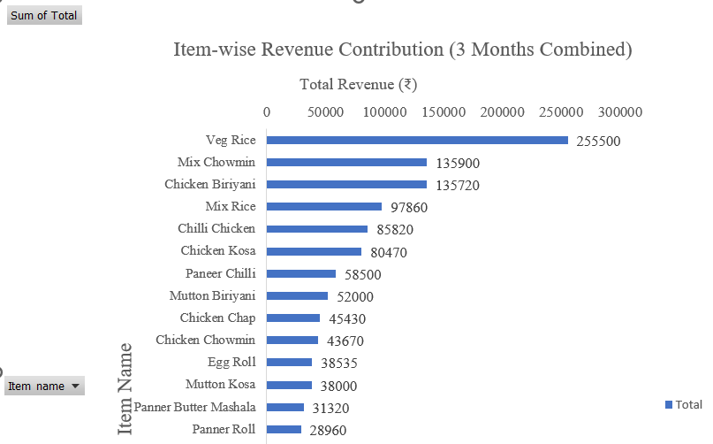
Item-wise & Pareto Analysis
Figure 4: Pareto Analysis of Item-wise Revenue
Figure 3: Item-wise Revenue Contribution
Insights:
Approximately 48% of items contribute around 80% of total revenue
Few items contribute majority revenue
Veg Rice , Mix Chowmin & Chicken Biriyani lead sales

Slide 7
Category-wise Performance
Figure 6: Category-wise Quantity Sold Comparison
(3 Months Combined)
Figure 5: Category-wise Revenue Comparison
(3 Months Combined)
Insights:
Rice: ~ 26%
Chicken: ~ 19%
Rice & Chicken dominate revenue
Starters & Mutton underperform

Slide 8
Key Insights & Revenue Drivers
• Revenue peaked in January (~₹4.84 lakh) due to festive/New Year demand
• Wednesday shows highest revenue → indicates strong mid-week demand pattern
• ~48% of items contribute ~80% of total revenue
→ shows concentration of revenue in fewer items (Pareto effect)
• Rice and Chicken categories dominate
→ reflects customer preference and high demand
Revenue Drivers:
Quantity Driven | Price Driven
High demand | High price Veg Rice (30 units) | Mutton Biryani (₹250)

Slide 9
Recommendations
• Focus on high-performing items (Veg Rice, Mix Chowmin, Chicken Biryani)
• Maintain stock for Rice & Chicken categories (high demand)
• Increase staff/preparation on Wednesdays
• Use pricing strategy for high-value items
• Introduce promotions during non-peak periods (Feb slowdown)

Slide 10
Conclusion
• Revenue analysis of 3 months shows clear demand patterns
• Sales are influenced by seasonal trends and mid-week peaks (Wednesday)
• Revenue is concentrated in a few high-performing items and categories
• Revenue is driven by quantity sold (demand)
• Data-driven insights help improve decision-making and business performance
Thank You

